Slide 1



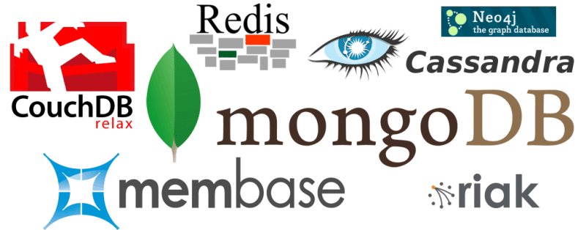
NoSQL Databases
NoSQL Concepts
SoftUni Team
Technical Trainers
Software University
http://softuni.bg

Slide 2

Table of Contents
NoSQL Databases
Overview
Non-Relational Data Models
Advantages of NoSQL
Disadvantages of NoSQL
Relational vs NoSQL Databases
When to use NoSQL?

Slide 3



NoSQL Databases
Overview, Models, Concepts, Examples

Slide 4
What is NoSQL Database?
NoSQL
Non-relational database
Schema-free document storage
Still support indexing, querying and CRUD operations
Still supports concurrency and transactions
Can have nested values
Highly optimized for append / retrieve
Great performance and scalability
NoSQL == “No SQL” or “Not Only SQL”?

Slide 5
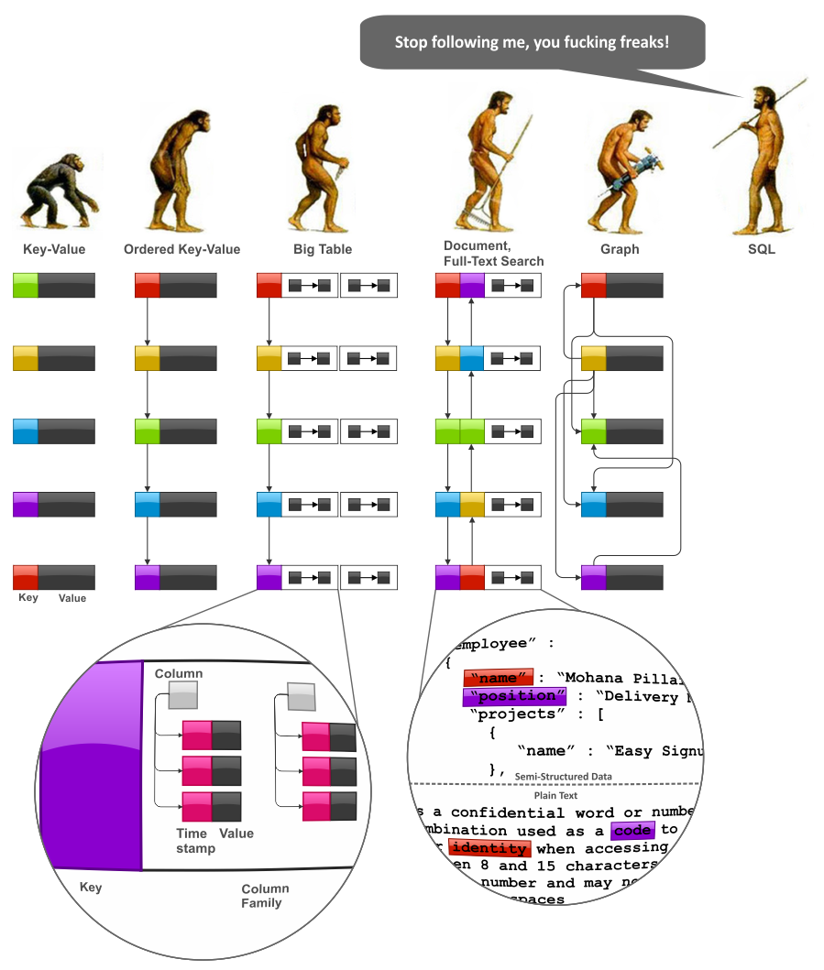
Non-Relational Data Models

Slide 6






Non-Relational Data Models
Document model
Set of documents, e.g. JSON strings
Key-value model
Set of key-value pairs
Column model
Stores data tables as sections of columns of data
Graph model
Use a graph structure

Slide 7

Document Model
Implementations of the document model may include:
Collections
Tags
Non-visible metadata
Directory hierarchies
Buckets
Name: Svetlin Nakov
Gender: male
Phone: +359899123456
Address:
- Street: Tintyava 15-17
- Post Code: 1113
- Town: Sofia
- Country: Bulgaria
Email: info@softuni.bg
Site: https://softuni.bg

Slide 8
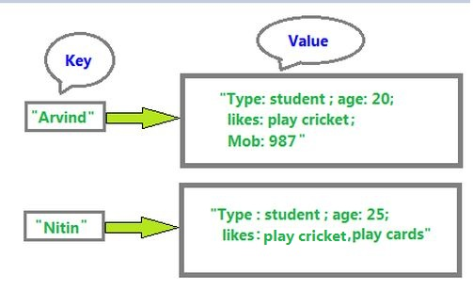
Key-Value Model
Data is stored in unstructured records
Records consist key + the values associated with that record
Not adequate for complex apps
The simplest form of DBMS

Slide 9
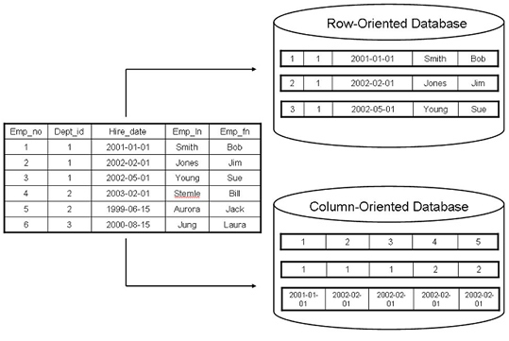
Column Model
Stores data tables as sections of columns of data rather than as rows of data
Has advantages for:
Data warehouses
CRM
HOC systems
More efficient in computation over many rows

Slide 10
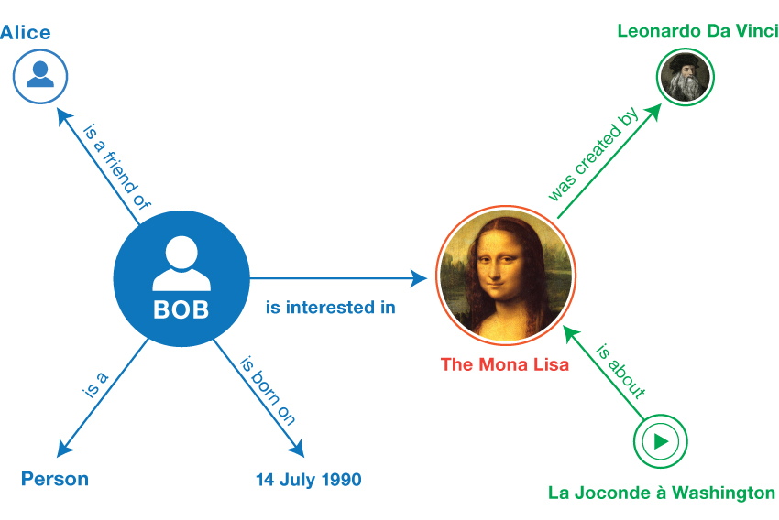
Graph Model
Graph databases employ nodes, edges and properties
Based on graph theory
Nodes represent entities
Edges are the lines that connect nodes to nodes
Properties are pertinent information that relate to nodes

Slide 11

Advantages of NoSQL
Cheap and easy to implement
Data are replicated and can be partitioned
Easy to distribute
Don't require a schema
Can Scale up and down
Quickly process large amounts of data

Slide 12

Disadvantages of NoSQL
Data is generally duplicated, potential for inconsistency
No standardized schema
No standard format for queries
No standard language
Difficult to impose complicated structures
Depend on the application layer to enforce data integrity
No guarantee of support

Slide 13
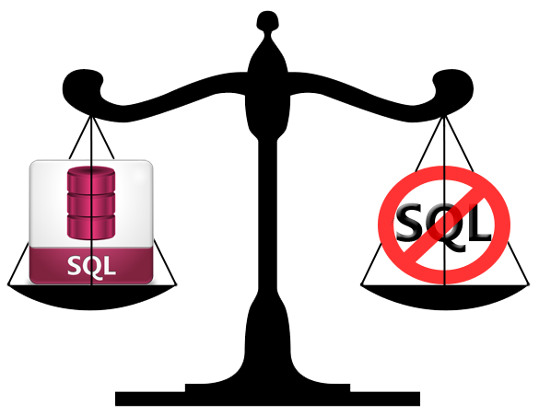
Relational vs. NoSQL Databases
Relational databases
Data stored as table rows
Relationships between related rows
Single entity spans multiple tables
RDBMS are very mature, rock solid
NoSQL databases
Data stored as documents or other values
Single entity (document) is a single record
Documents do not have a fixed structure

Slide 14
Relational vs. NoSQL Models
Relational Model
Document Model
Name | Svetlin Nakov
Gender | male
Phone | +359988123456
Email | info@softuni.bg
Site | http://softuni.bg
Name: Svetlin Nakov
Gender: male
Phone: +359899123456
Address:
- Street: Tintyava 15-17
- Post Code: 1113
- Town: Sofia
- Country: Bulgaria
Email: info@softuni.bg
Site: https://softuni.bg/
*
1
Street | Tintyava 15-17
Post Code | 1113
*
1
Town | Sofia
*
1
Country | Bulgaria

Slide 15
When to use NoSQL?
The data is not structured or structure is changing
You need to have a denormalized representation of your data
You need massive write performance
You need fast key-value access
You need flexible schema/data types
You need schema migration
You need easier maintainability
http://highscalability.com/.../what-the-heck-are-you-actually-using-nosql-for.html

Slide 16



Summary
How column-oriented databases store data?
What are the main elements of graph model?
What are the main 3 advantages of NoSQL?
What are the main 3 disadvantages of NoSQL?
When to use NoSQL?
Databases

Slide 17







NoSQL Databases
https://softuni.bg/courses/databases

Slide 18
License
This course (slides, examples, demos, videos, homework, etc.) is licensed under the "Creative Commons Attribution-NonCommercial-ShareAlike 4.0 International" license
Attribution: this work may contain portions from
"Databases" course by Telerik Academy under CC-BY-NC-SA license

Slide 19





Free Trainings @ Software University
Software University Foundation – softuni.org
Software University – High-Quality Education, Profession and Job for Software Developers
softuni.bg
Software University @ Facebook
facebook.com/SoftwareUniversity
Software University @ YouTube
youtube.com/SoftwareUniversity
Software University Forums – forum.softuni.bg

